Slide 1

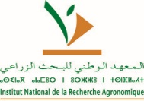

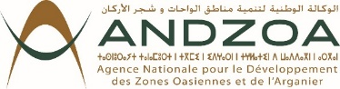
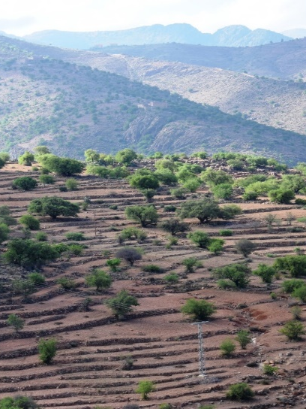
Impact of climate change on the argan tree and the argan ecosystem: scientific evidence and strategic implication
Faouzi Bekkaoui,
Inaugural Conference of the International Argan Congress
10 May 2024, Essaouira, Morocco

Slide 2
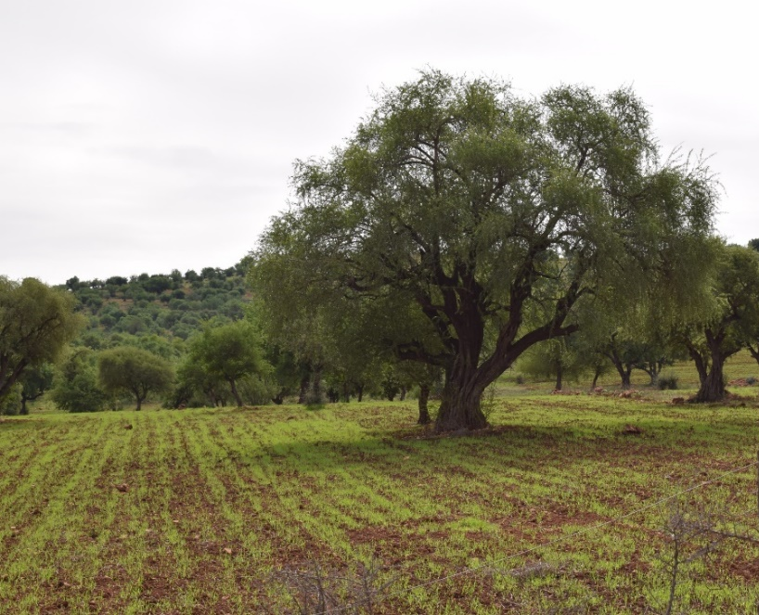
Outline
Argan Tree : Socio-economic Importance, Biology, Ecology
Climate change (CC) in Morocco
Impact of CC: on the argan Agro-Sylvo-Pastoral System & Socio-Economic Implications
Adaptation strategies to climate change
Contribution of the arganeraie to Carbon Sequestration
Key messages & Perspectives

Slide 3
The Argan Tree

Slide 4

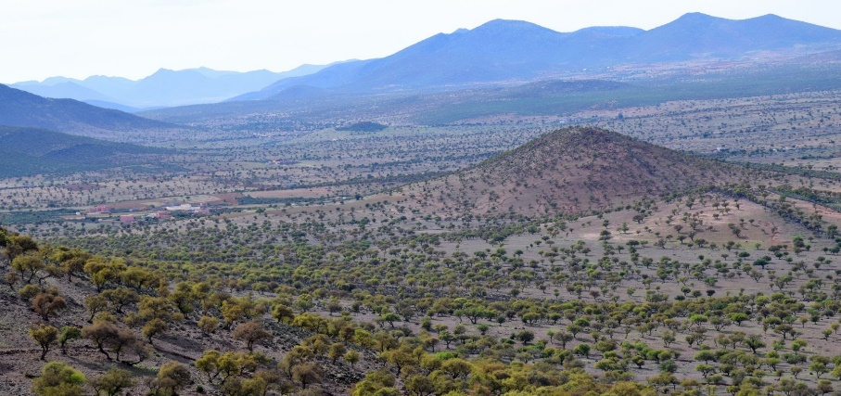
Argan in Morocco
The argan tree: endemic species of Morocco, vital for the local ecosystem
The argan tree plays an ecological and economic role in semi-arid areas.
Diverse Applications: human and animal food, cosmetics, energy production
Economics Impact: argan industry sustains a vast network of livelihoods, with over 150,000 households directly involved, supported by 850 cooperatives and more than 500 private companies
Land Utilization : 9% share of the National agricultural land
Economic value: 4 000 to 5 000 T of argan oil
Export Dynamics: In 2023, 660 T of argan oil for 25 Mi USD

Slide 5
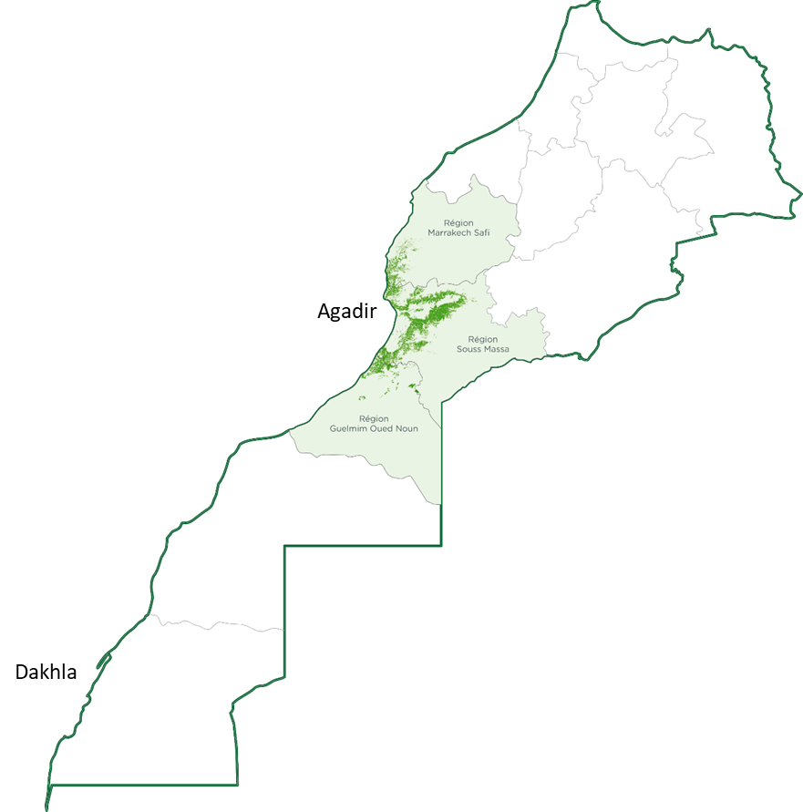
Argan Biosphere Reserve
Argania spinosa an endemic species
A Biosphere Reserve in 1998
830.000 ha
+3 million inhabitants
A Globally Important Agricultural Heritage Systems (GIAHS) in 2018
11 Ecosystems : Rich Biodiversity with high endemism (1 240 plant species, 660 Animal species)
High agricultural farming system diversity (agro-sylvo-pastoral) mainly on terraces
A corridor against desertification

Slide 6
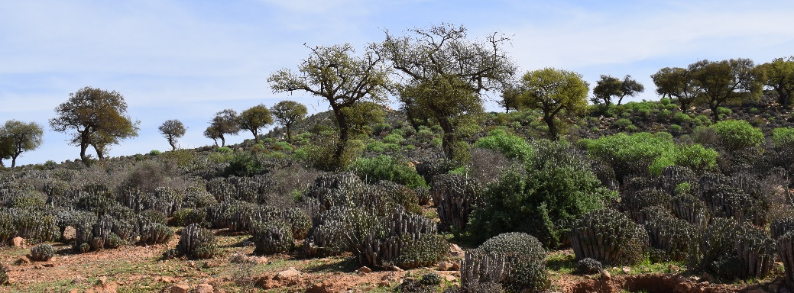
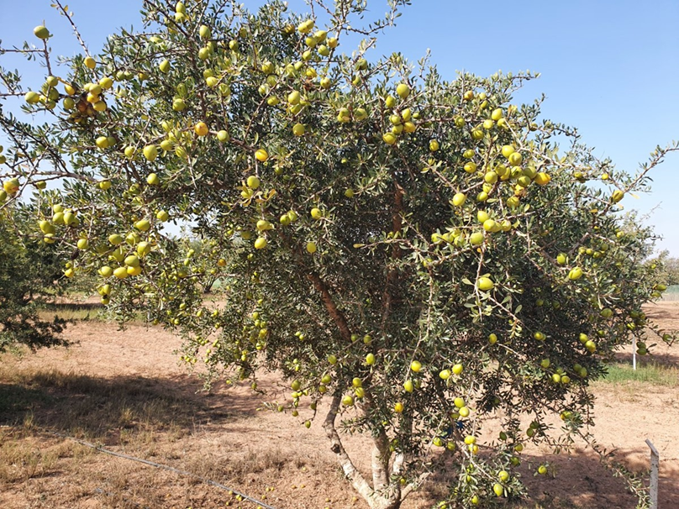
Biology of Argan
Species : Argania spinosa, Sapotaceae family, one species?
Life span : up to 200 years, showcasing its longevity and resilience
Physiology : tolerant to drought (100 mm of rainfall) and survive temperatures up to 50°C
Multiplication by seed, relative recalcitrance to vegetative multiplication

Slide 7
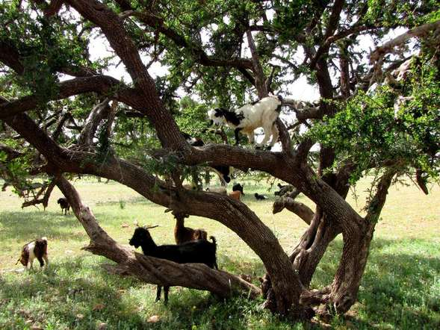
Argan: ecosystem biodiversity
The tree
The other plants
The goats
The insects / the pollinators
The lichens
The soil microorganism / Mycorrhizae

Slide 8
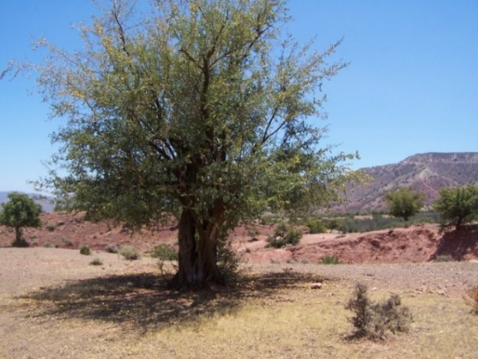
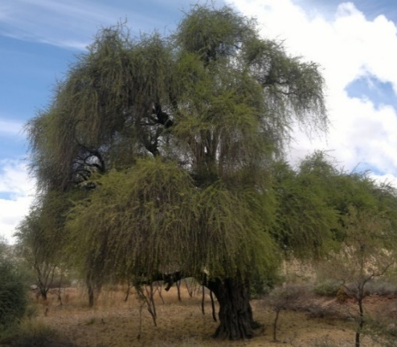
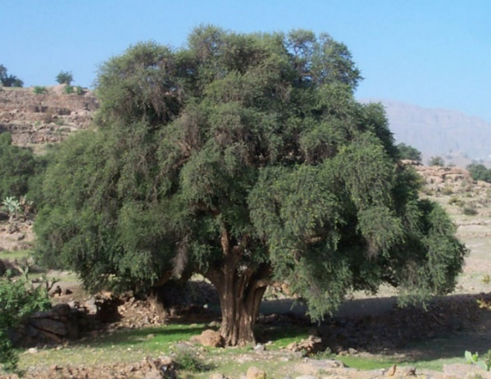
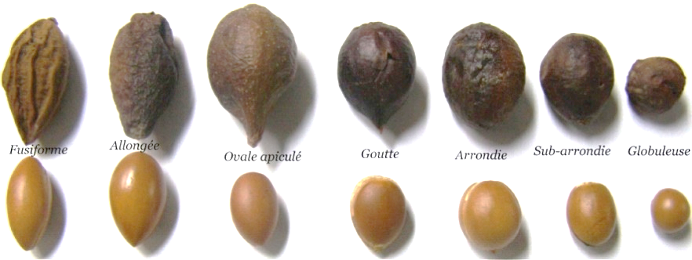
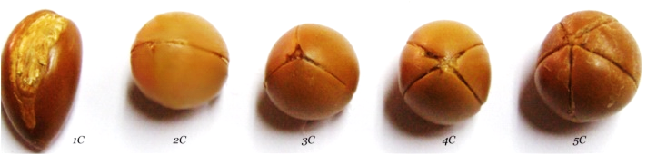
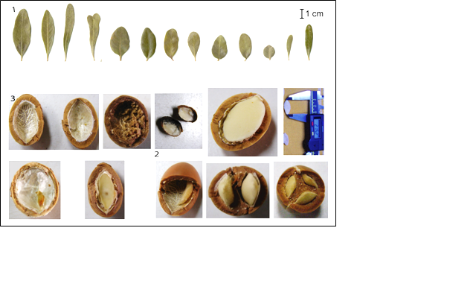
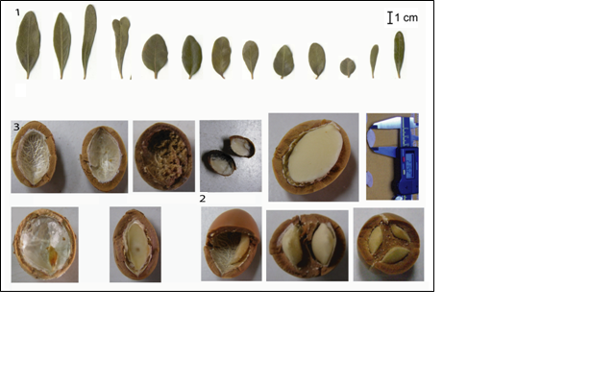
The Argan tree diversity
Tree shape
Presence of spines
Leaf shape and size
Fruit/Seed/nut size and shape

Slide 9
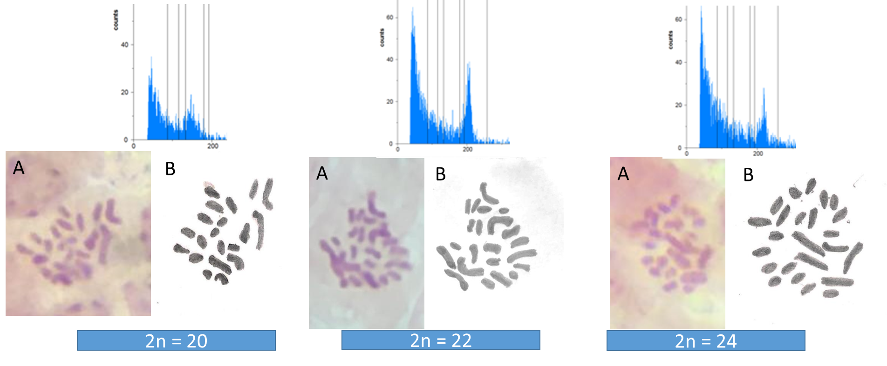
The genetics : more than one species ?
Cytogenetics studies have shown that there could be three variants or putative species of Agran based on:
Chromosome numbers , Flow cytometry and Cross pollination studies
Potential Impact

Slide 10
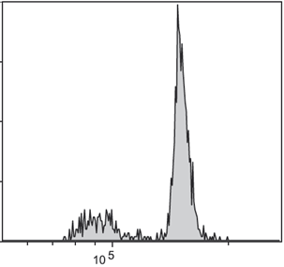
Genetic/Genomic of Argan
Genome size: 806 MB, Sequenced/assembled 670 MB
+ 200 000 Markers identified
Chloroplast completely sequenced 156 KB- 122 genes
Study Impact
Effective assessment of the genetic diversity of argan germplasm
Strengthening of the Conservation of genetic resources of the Argan Tree
Molecular assisted selection of elite germplasm

Slide 11
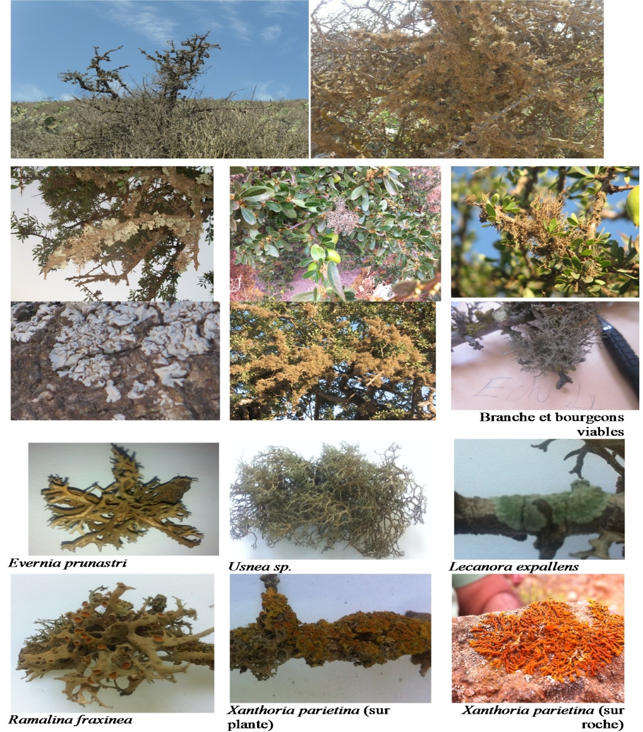
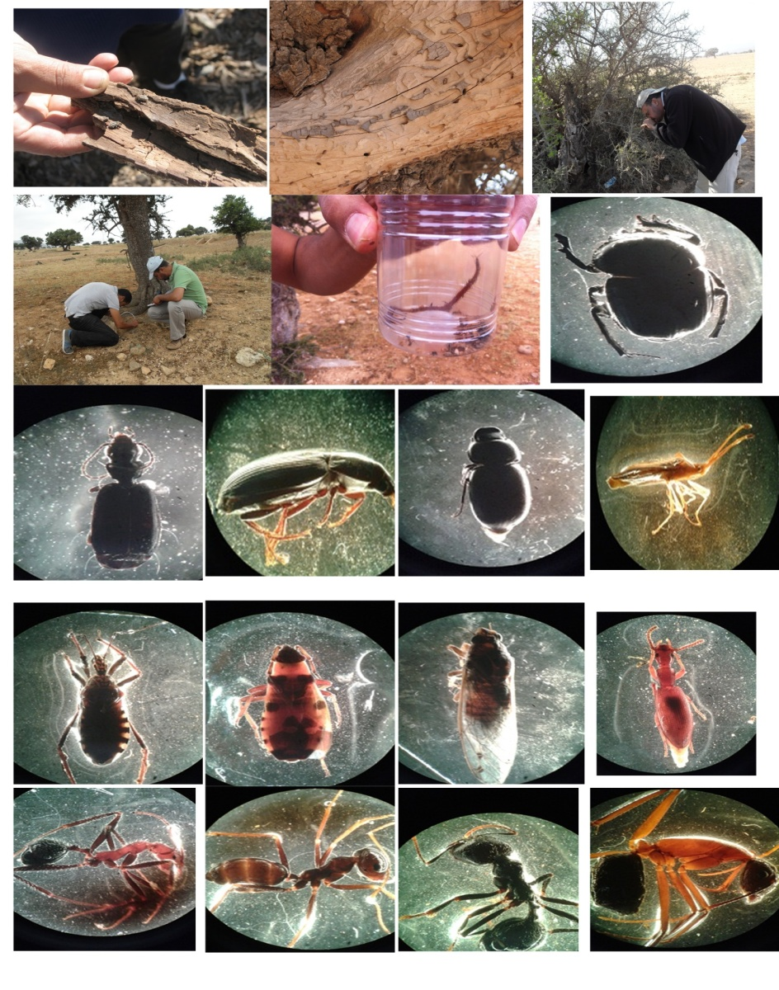
Biodiversity of lichens & entomofauna of Biodiversity of lichens & entomofauna of the “Argan tree” ecosystem
11 species of lichens identified up to now
Ants: 54% ; Coleopters: 10%

Slide 12
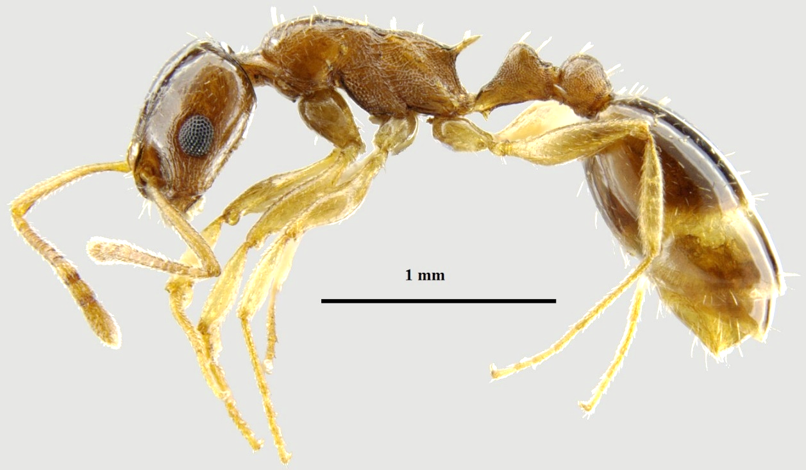
Themnotorax Ant
T. tamriensis can be described as "rare" and undoubtedly "localized" because it was unknown until now
Unless discovered elsewhere, T. tamriensis would have a bio-indicator value for the Arganeraie;
T. tamriensis also represents a new example of the importance of Morocco as a center of evolution of North African myrmecofauna.

Slide 13
Climate change

Slide 14
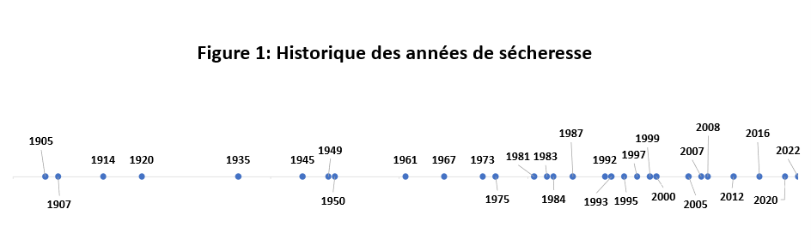
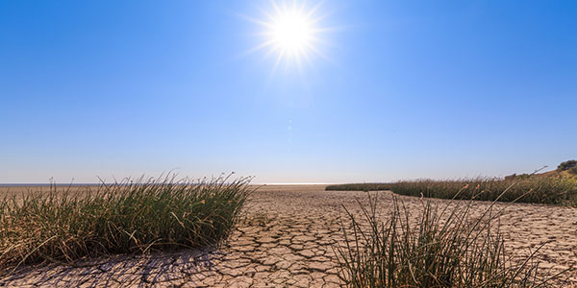
History of drought years - 1900-2023
Drought year : less than 250 mm rainfall
Rainfall distribution is important
1900-1925 4
1926-1950 4
1951-1975 4
1976-2000 10
2002-2023 8

Slide 15
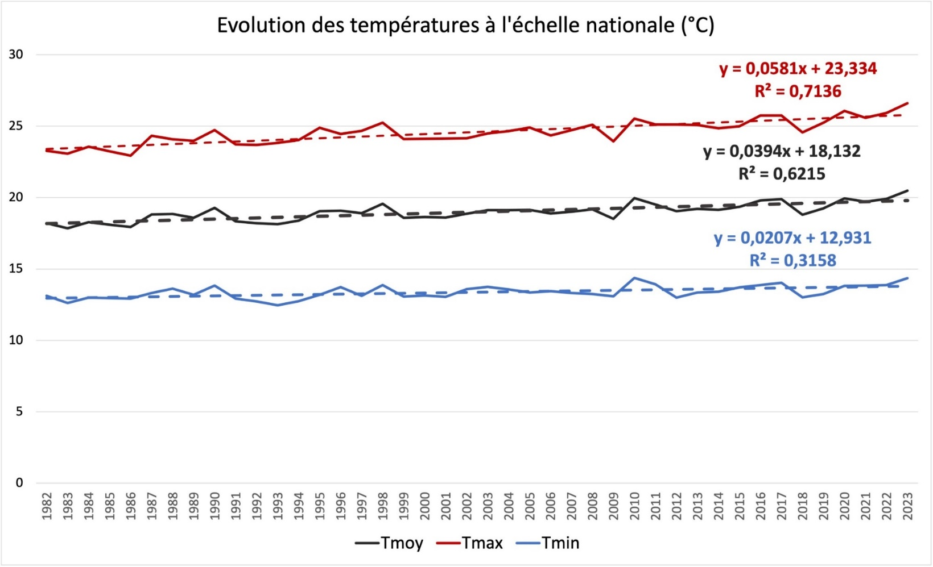
Temperature evolution in Morocco 1982-2023
Significant increase over the years :
Tem Max : 0,06 °C/y
Tem Moy : 0,04 °C/y
Tem mini: 0,02 °C/y

Slide 16
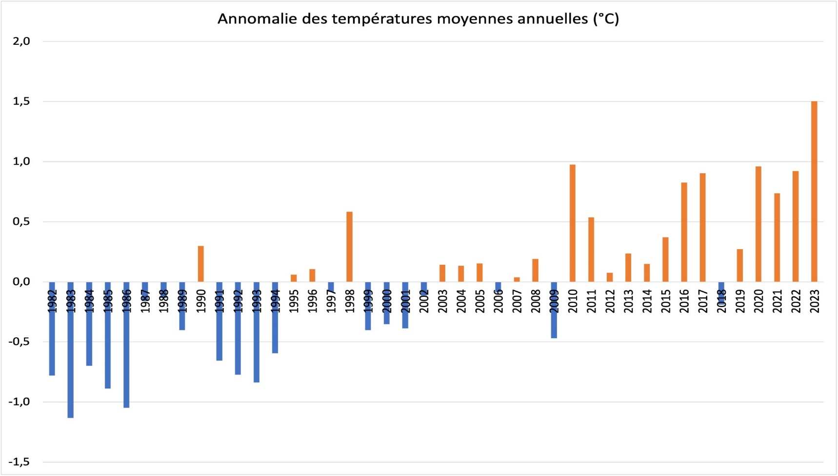
Deviation of the Average Temperature in Morocco

Slide 17
The impact of Climate change

Slide 18
The impact of CC on the environment and socio-economics
Socio-Economic aspects
Low argan fruit production
Argan oil price increase
Revenue of small farmers / Cooperatives decrease
Reduction of export
Price fluctuation of argan products
Migration to cities
Environment
Soil loss
Terraces abandonment
Erosion
Biodiversity loss
Farming system mutation

Slide 19
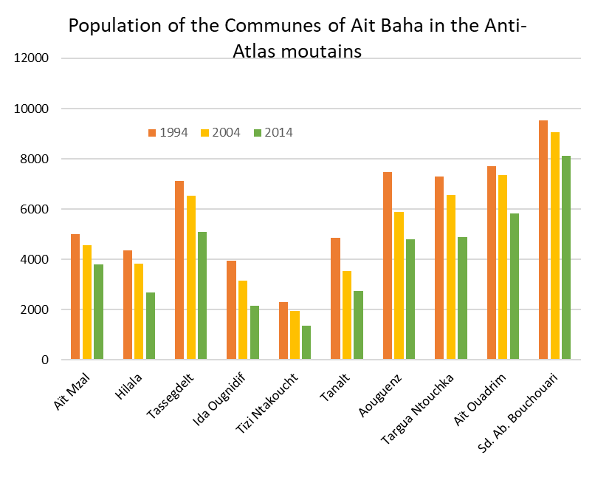
CC impacts in the mountainous areas
Overall decrease of the population in all municipalities (10 to 50 %)

Slide 20
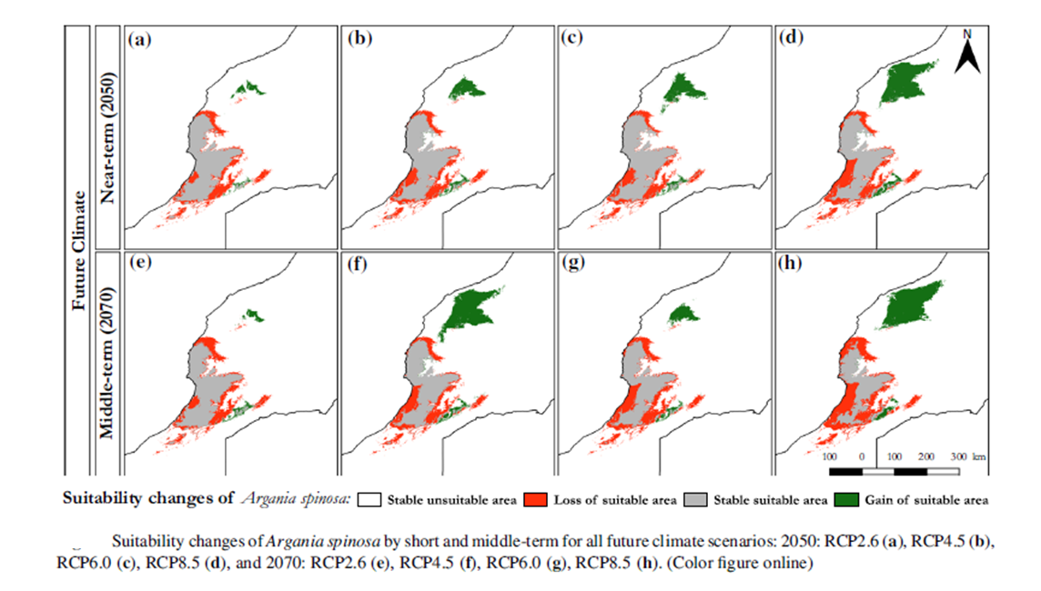
Impact of CC on Argan distribution
Loss of areas suitable for argan tree adaptation within the ABR and expansion observed towards the north.
(S. Moukrim et al., 2019)
Studies implemented in different sites of the Argan Biosphere Reserve (ABR) , reported degradation levels vary from one area to another and depend on the nature of the pressures they are subjected to:
In the province of Taroudant a density loss of 44, 5% between 1970 and 2007, (Polain Waroux, 2011)
In the Haha Argan forest revealed a density loss rate estimated at 2% in 22 years and a surface loss of 0.21% in 13 years. (El Wahidi, 2013).
In the mountainous area of Ait Baha, an estimated 2 to 3% of the trees present in 2003 disappeared in 2011.

Slide 21
Adaptation strategies

Slide 22
Adaptation strategies
Natural Forest restauration and improved management practices (Stratégie Forêts du Maroc)
Terraced Agroforestry System (TAS): ancient farming practices combining seasonal crops such as cereals and legumes, and perennials ones including almond (Prunus dulcis), prickly pears (Opuntia ﬁcus- indica), and ﬁgs (Ficus carica), Argan (Argania spinosa)…. improved with the arganiculture program
Optimized growing methods
Selection of genotypes with better tolerance to drought and heat and vegetative multiplication
Terraced Agroforestry System in Ait Baha (Argan/Annual crops)

Slide 23
Reforestation program
Natural forest
Objective : restauration 2020-2030 : 400 000 ha
Accomplishments : Natural forest restauration 209 000 ha (2012-2020)
Arganiculture (an agroforestry system to alleviate pressure on the natural forest)
Objective 2025-2030 : 50 000 ha (Generation Green)
Accomplishments 2018-2025 : 10 000 ha (Morocco Green Plan)

Slide 24
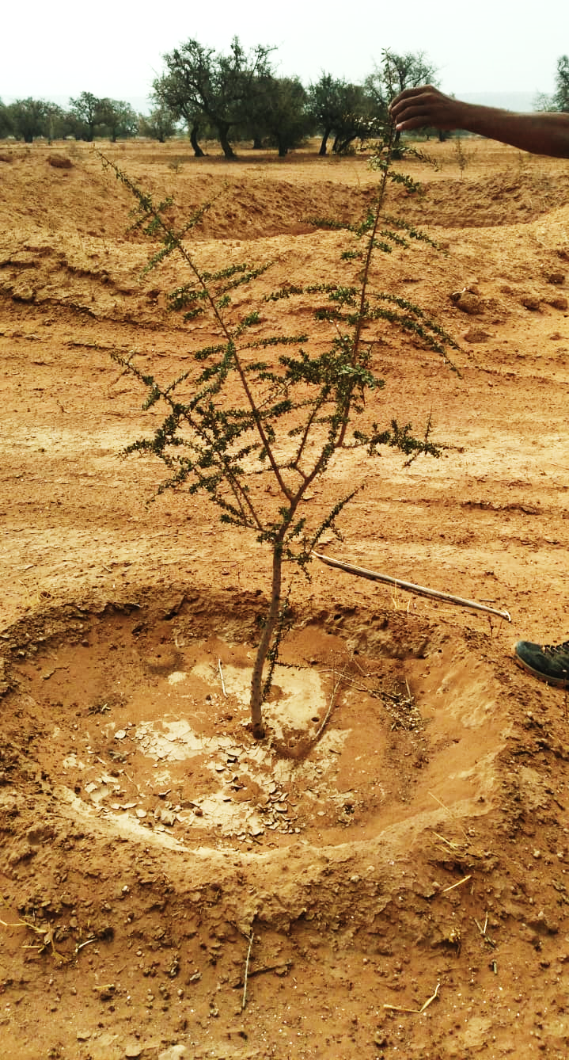
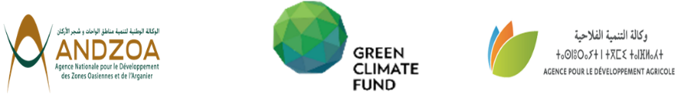

Establishing argan orchards in degraded environments
Combining forest restoration and agricultural landscape rehabilitation:
Planting argan orchards on private land
Practicing adapted farming system with alley cropping « argan+Aromatic and Medicinal Plants -AMP »
Refarming abandoned agricultural land and terraces
Alleviate anthropic pressure on natural forest
Improve Carbone sequestration
Improve resilience
Green Climate Fund project 50 M USD with 20% Cofunding. (DARED project)

Slide 25
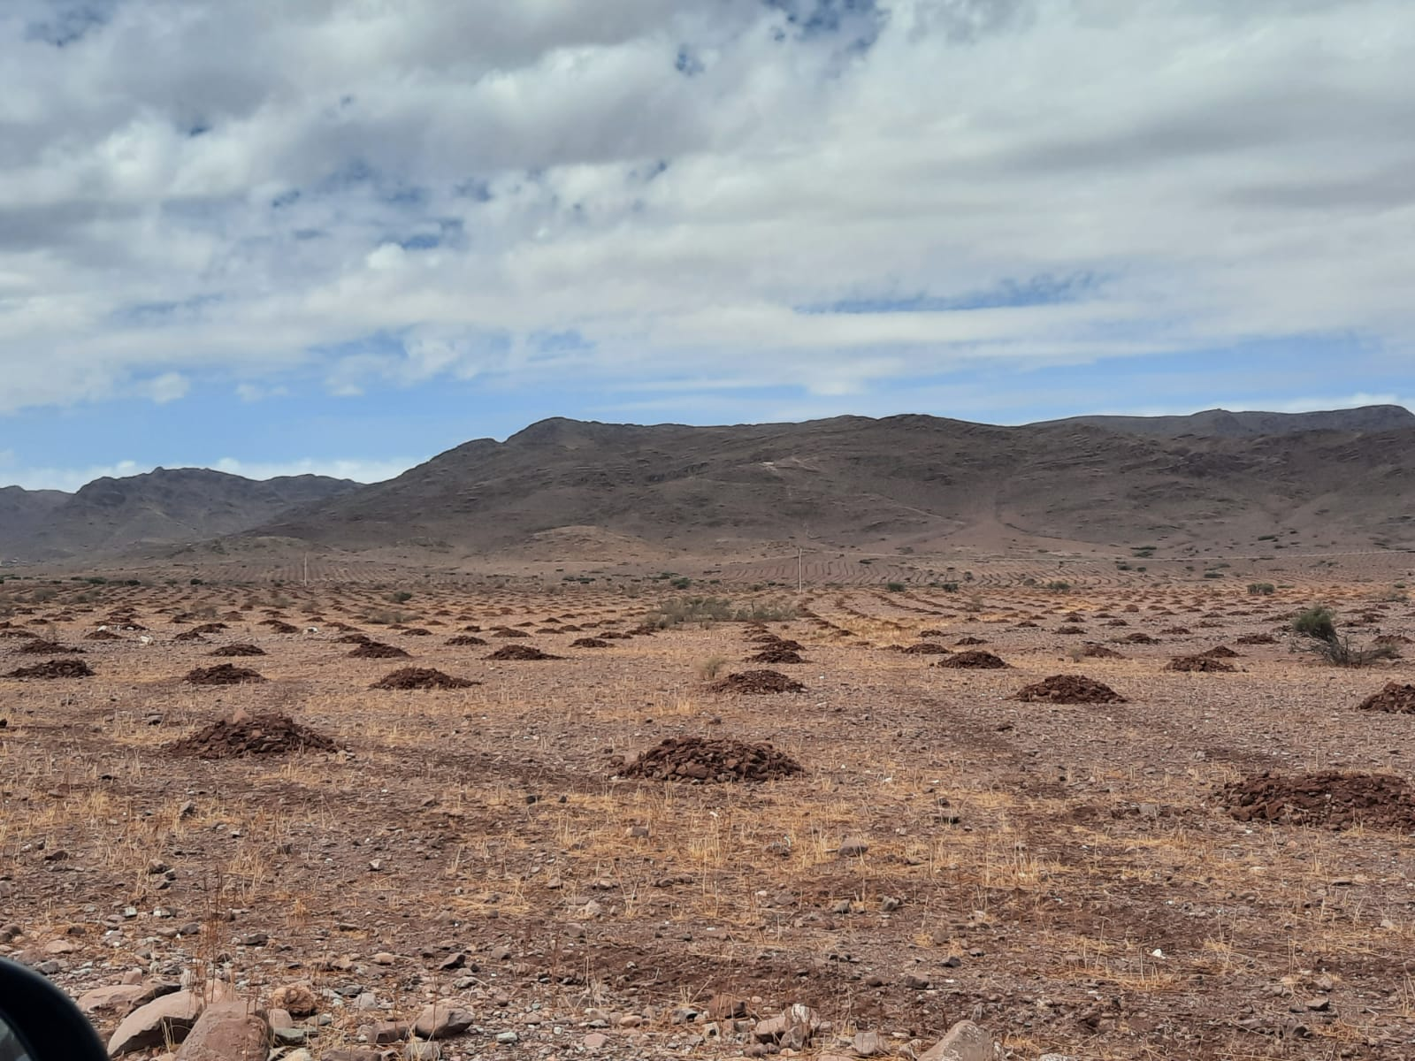
Arganiculture
Participatory approach
Agreement with more than 50 NGOs
Planting 10.000 ha of argan orchards
within 2.000 ha as alley cropping (argan trees+ Aromatic and Medicinal Plants- AMP)
in the 8 provinces of the argan area
Potential impacts
Improved return/ha compared to barley:
Argan: from 150 USD/ha to 400 USD/ha
Case with argan+caper 400 + 500 USD /ha

Slide 26

Optimised growing conditions
DARED Project
Production techniques
Soil preparation, especially the dimensions of the planting holes (60 cm3) Bowl and impluvium depending on the topography of the land Shallow and deep mulching for growth Compost input
Intensive management irrigation (+300 plants/ha) (1800 to 3200 m3/ha depending on the age of the plants) Pruning young plants

Slide 27
Optimized growing conditions
Production techniques
Soil preparation, especially the dimensions of the planting holes (60 cm3)
Bowl and impluvium depending on the topography of the land
Shallow and deep mulching for growth
Compost input
Intensive management irrigation (+300 plants/ha) (1800 to 3200 m3/ha depending on the age of the plants)
Pruning young plants

Slide 28
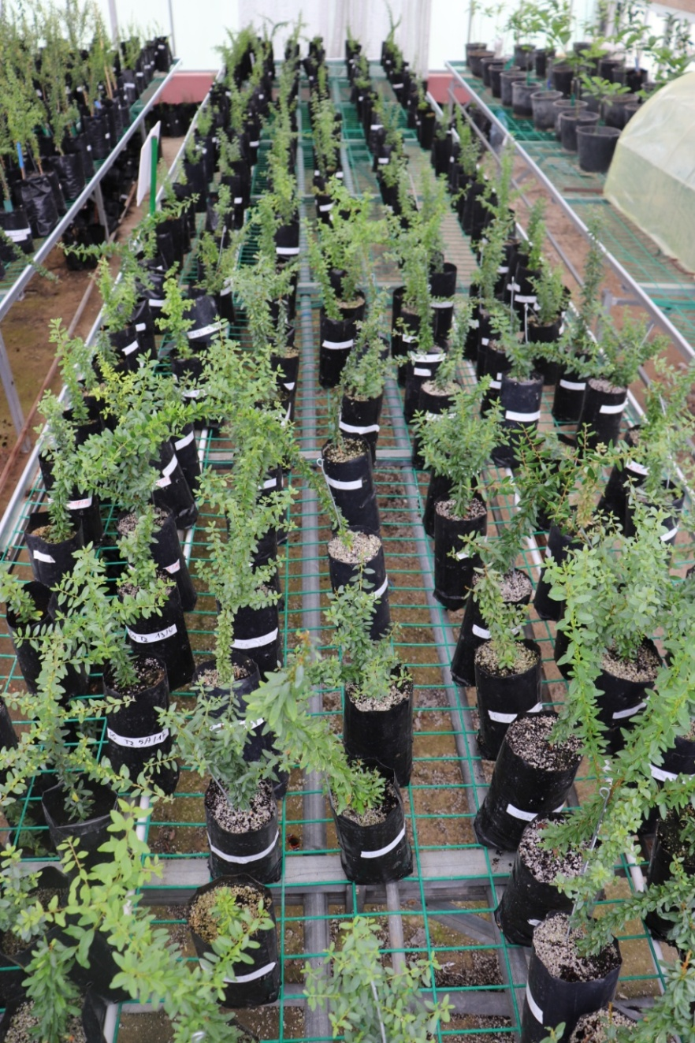
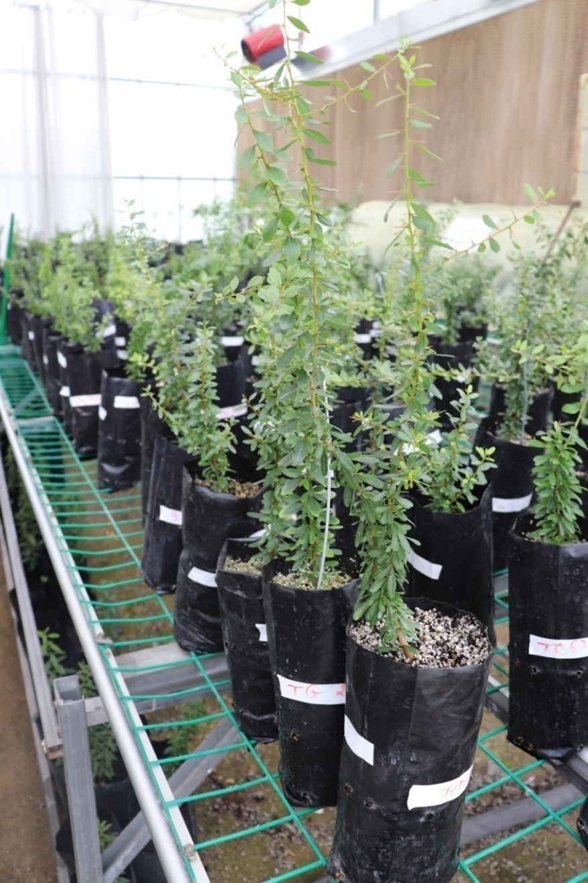
Mass production of registered varieties by grafting and cuttings
13 varieties registered by INRA
Transfer to nurseries for mass propagation by grafting and cuttings

Slide 29
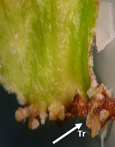
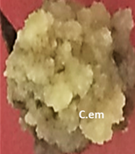
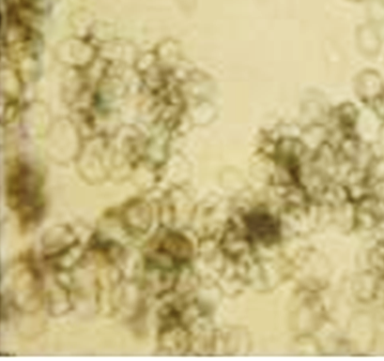
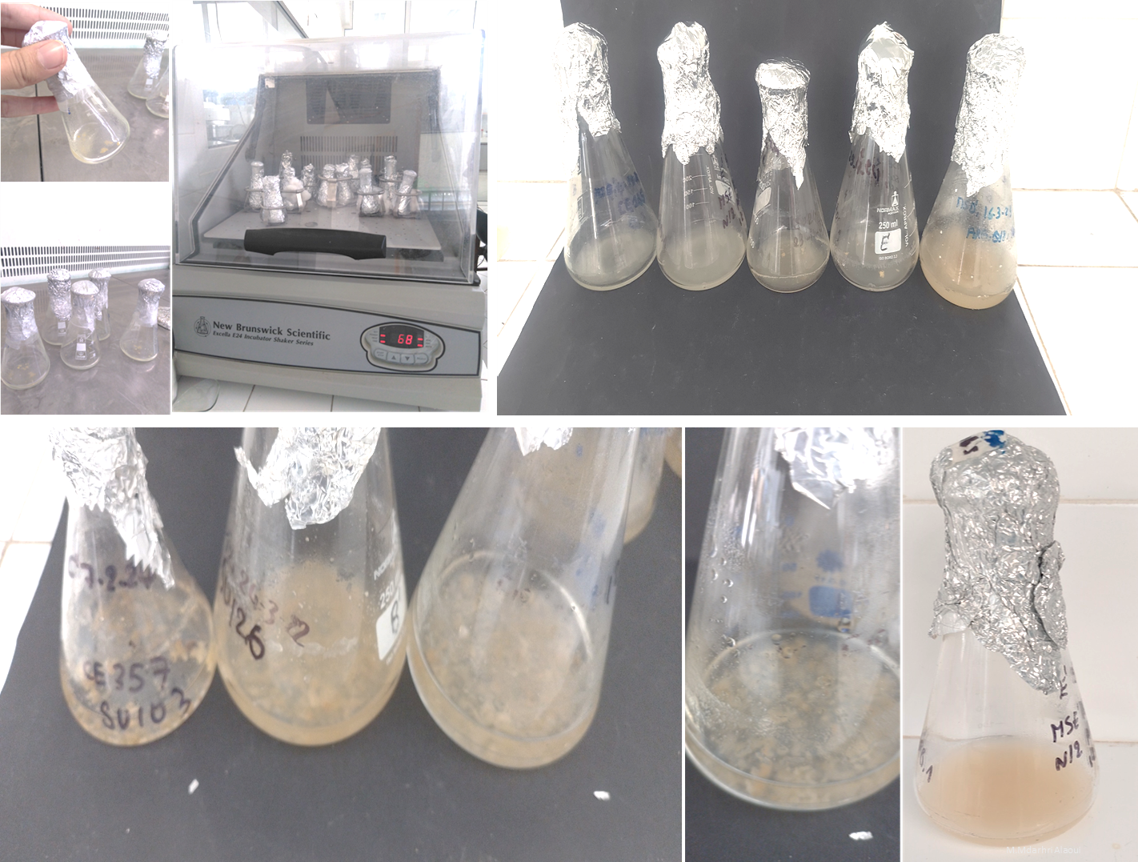
Somatic Embryogenesis
Advantages
True to type
Complete rejuvenation when using old material
High throughput multiplication

Slide 30
Carbon sequestration

Slide 31
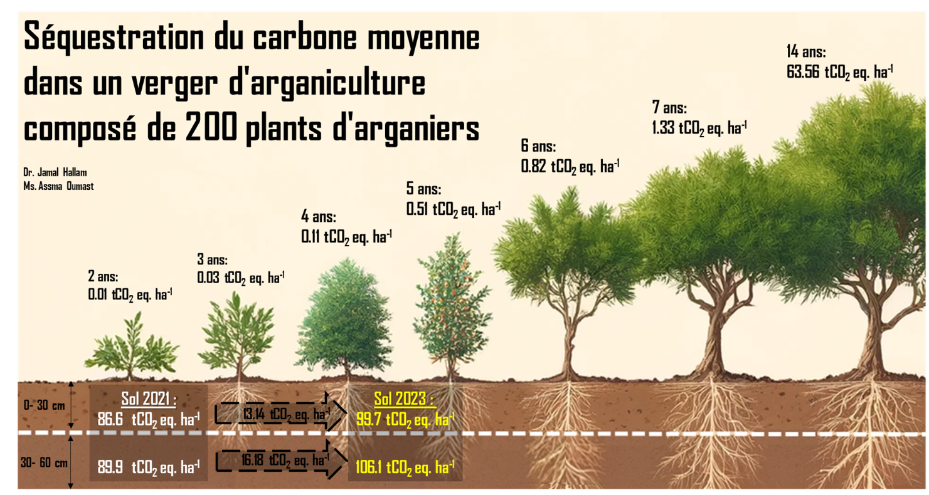


Evaluation of the CO2 sequestration potential of an argan orchard
DARED
Project

Slide 32
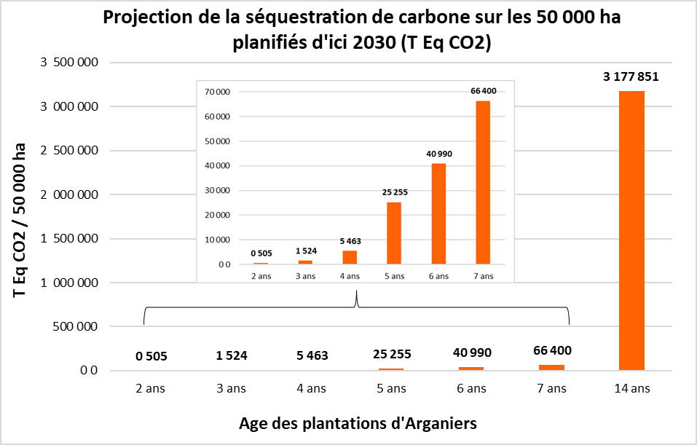
Average potential for CO2 sequestration in the biomass of argan plants as a function of age on the 50,000 hectares of argan farming planned by 2030
DARED Project
On average, this corresponds to the sequestration of CO2 emissions from approximately 1,271,140 cars.
Estimate is based on the emissions of a standard car using diesel, having traveled an average of 15,000 km at an average consumption of 5.6%, which represents approximately 2.5 tons of CO2 equivalent (value that we calculated at using the “GHG Emissions Report-Morocco” tool.

Slide 33
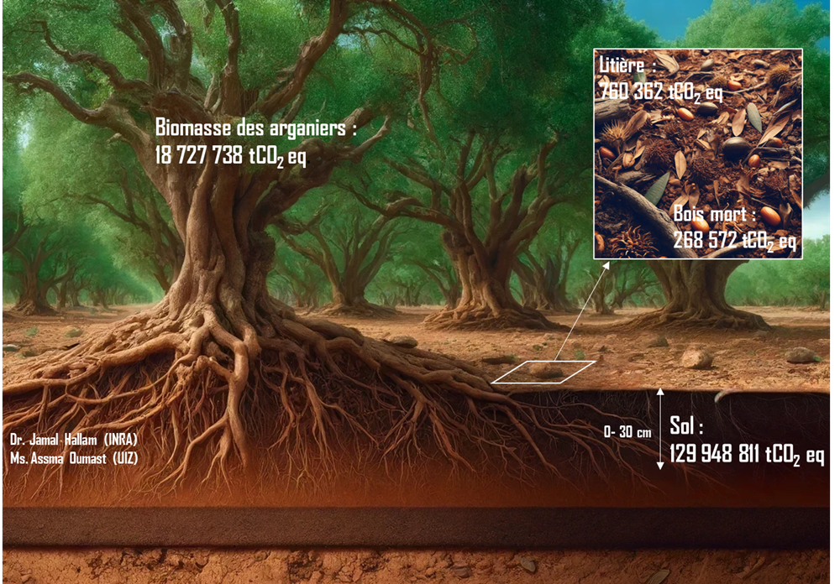
Total amount of carbon dioxide stored in the various reservoirs of the Argan forest.
Total sur toute la forêt :
DARED Project
Par hectare :
Moyenne de 19 tCO₂ eq ha⁻¹ (5.2 tC ha⁻¹)
Et peut atteindre jusqu’à 107 tCO₂ eq/ha (29 tC ha⁻¹) selon le type de peuplement
Total sur toute la forêt :
Par hectare :
Sol : Moyenne de 132 tCO₂ eq ha⁻¹ dont 16,67 imputables à l’impact de l’arganier
Notes:
Le bois mort sont prélevés dans les quadrats (1m x 1m). A l’intérieur de ce quadrat, un semi-quadrat de 0.5 m x 0.5 m pour collecter la litière de l’arganier

Slide 34
Carbon footprint of the argan sector
The carbon footprint associated with the argan oil production remains modest compared to other sectors , such as olive growing. The main emissions come from electricity consumption by cooperatives and transport linked to exports by companies.
Although the assessments reveal a net positive contribution of the argan sector to the greenhouse gas emissions reduction, it remains possible to implement measures to further improve this record.
To optimize the carbon footprint, it would be wise for cooperatives and companies to transition to solar energy usage, capitalize on the by-products of the argan tree through pyrolysis, and encourage argan farming as well as good orchard management practices.

Slide 35
Perspective / Key messages
Challenges
Climate change
Anthropomorphic factors
Opportunities
Biological diversity conservation
Reforestation / Generation Green Strategy and Forest du Maroc
Arganiculture – Agroforestery system
Carbon sequestration
Research, development and innovation
Enhanced understanding of the ecosystem
Novell methods : Genomics, somatic embryogenesis, AI, Precision Ag
Collaboration
Capacity development and effective participation of stakeholders
Professional organization

Slide 36
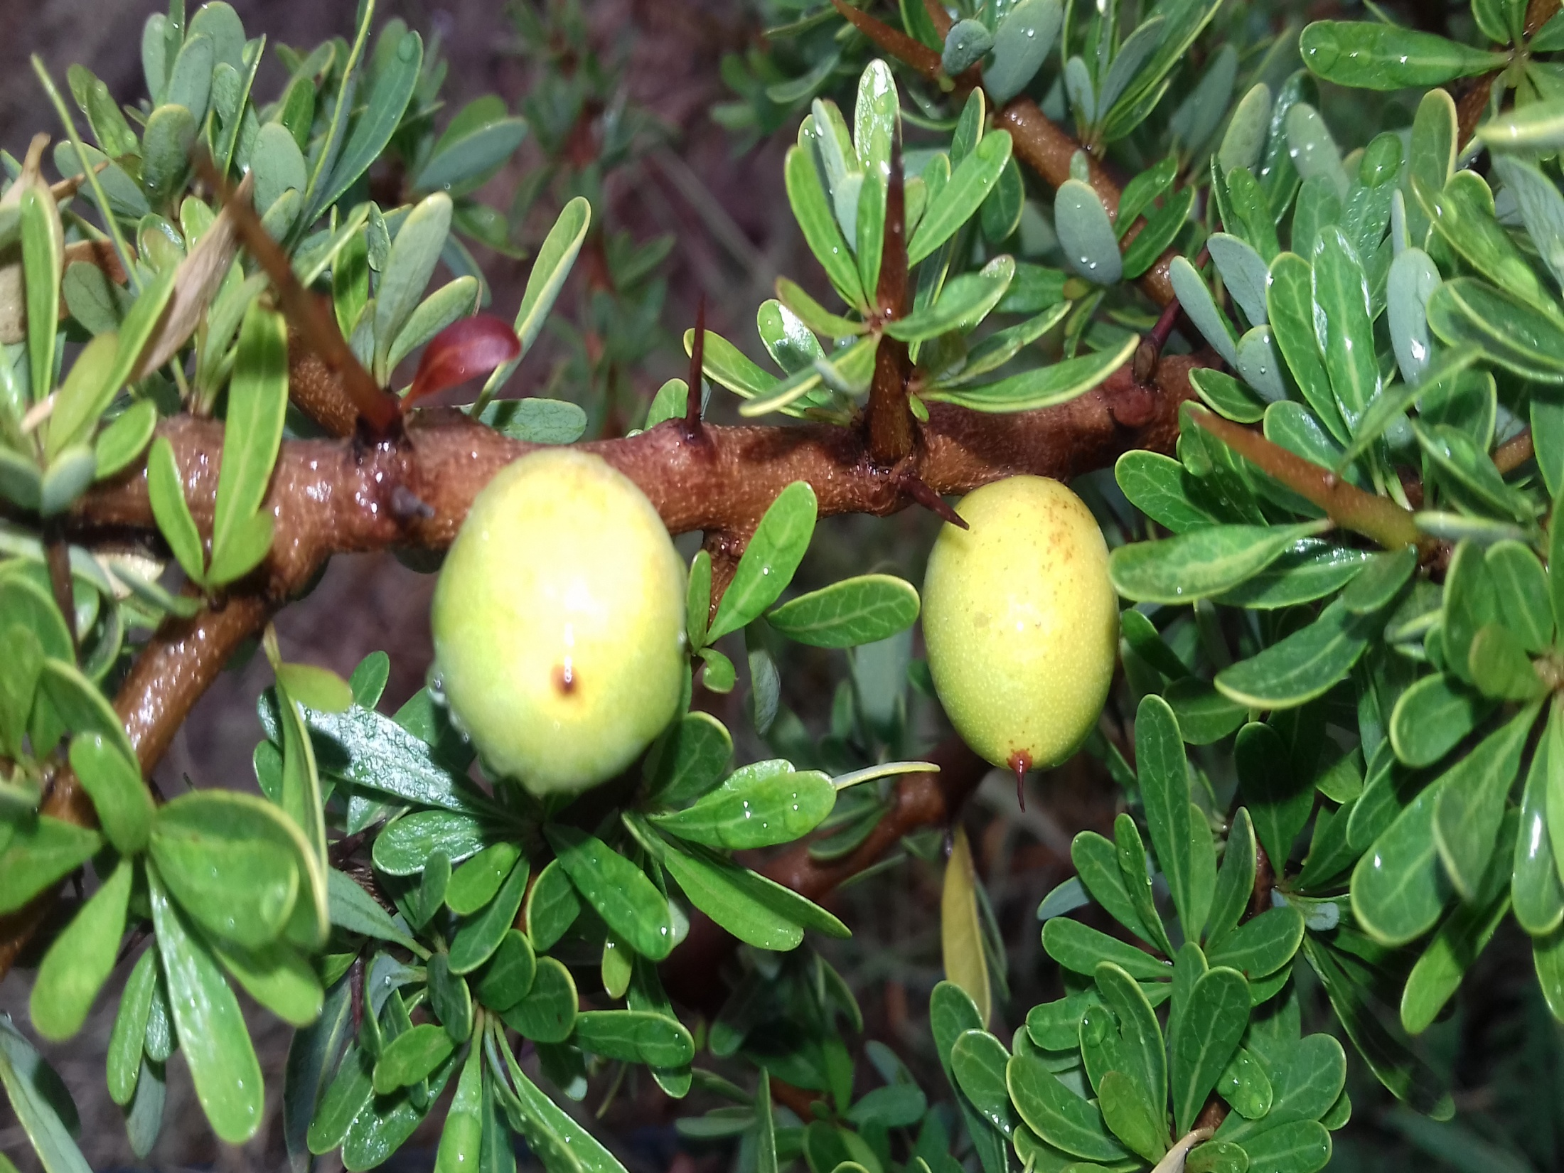
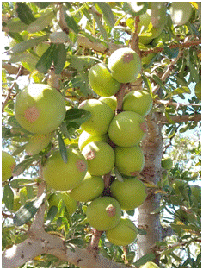
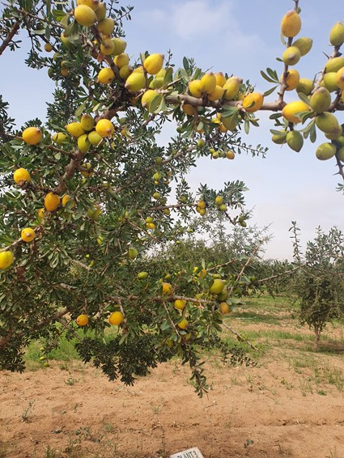

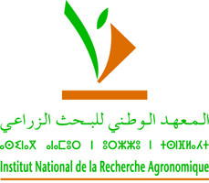

شكرا
Merci
Thank you
Acknowledgements :
Mr Abderrahmane Aitlhaj
Dr Abdelaziz Mimouni
Dr Rachid Bouharroud
Dr Jamal Hallam
Dr Imane Thami Alami
Dr Driss Iraqi
Dr Rachid Mentag
Dr Mariem Mdarhri Alaoui
Dr Rabha Abdelwahad

